Slide 1
Notes:
There’s a RITUAL CLEAN-UP that happens every year in our house… A CLEAN-UP we do – to get things looking neat and tidy for Christmas.

Slide 2
Notes:
…When the grass gets too long

Slide 3
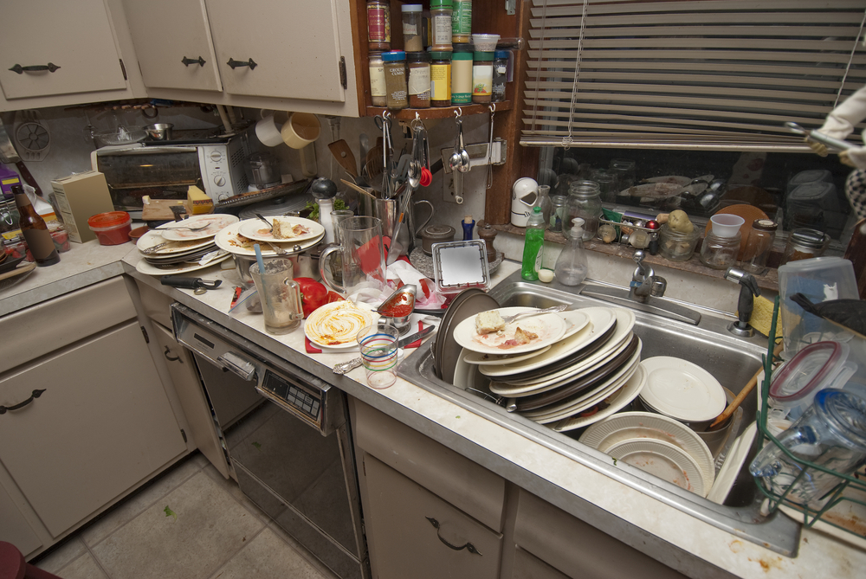
Notes:
…And the dishes too high
We mow the grass and wash the dishes

Slide 4
Notes:
…we get rid of the clutter and mess.
…and we CLEAN-UP for Christmas

Slide 5
Notes:
I see it with our neighbours too – THEY CLEAN UP FOR CHRISTMAS
…They get their gardens trimmed.

Slide 6
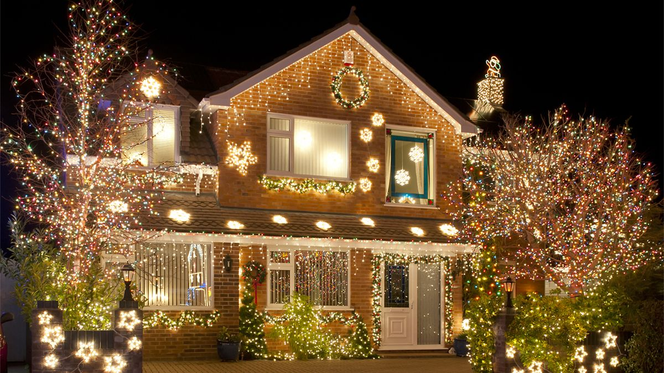
Notes:
…they get their lights happening. The neighborhood has never looked so good.
Everything is CLEAN and TIDY. ORDERED. NO MESS.
Ready for guests.

Slide 7
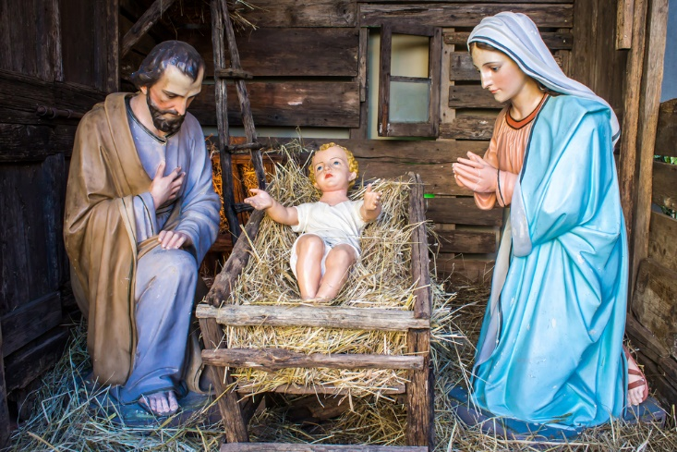
Notes:
And somewhere in the midst of this – the clean, tidy, happy occasion that Christmas is – we stick a nativity scene
…Some TACKY, SANITIZED nativity scene - with white baby-Jesus. Is that even a baby!?
…A CLEAN, TIDY birth - No MESS…No STRESS…Just happy smiling faces.
Which matches our IDEAL PICTURE of the Christmas season, doesn’t it?

Slide 8
Notes:
The clean house

Slide 9
Notes:
The happy families…

Slide 10
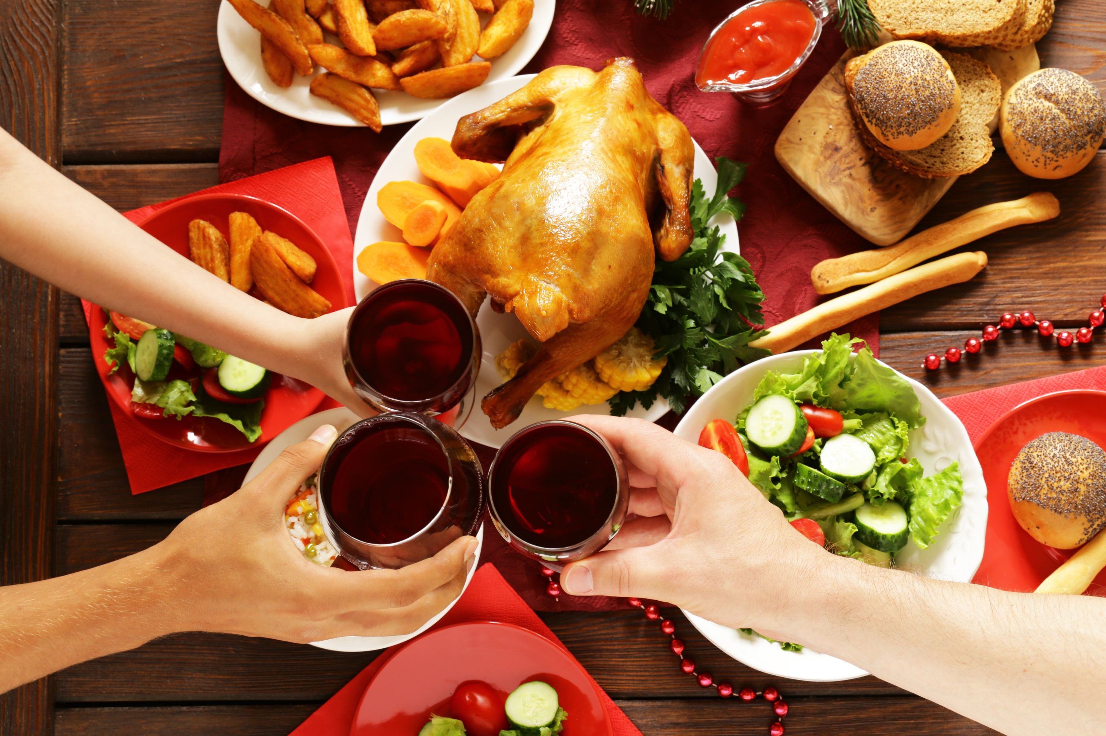
Notes:
The meals with people you love…

Slide 11
Notes:
Clean, tidy Jesus fits right in - Our IDEAL Christmas season.
Our hopes for happy times
Our longing for peace and order. NO MESS.
But for all the good things about the Christmas season – there’s no other time when IDEAL and REALITY are most at odds.

Slide 12
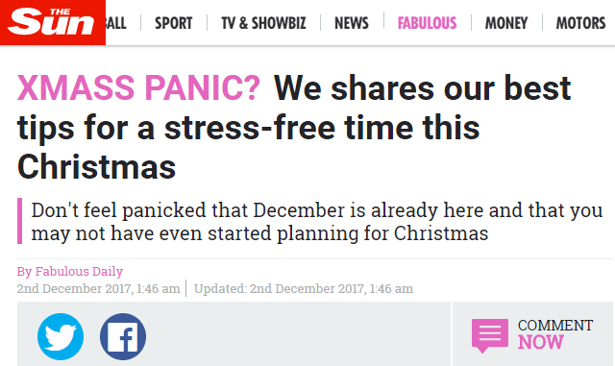
Notes:
For some of us - Christmas time is the most stressful time of the year.
Always looking for ways to minimize the stress.

Slide 13
Notes:
Between the work parties, the holiday planning, and Christmas arrangements
…the mess of kids, extended families, and working out who’s bringing the Christmas turkey…
…and that even our attempts to escape the mess just create more mess –
…like when your attempt to leave one MESSY PLACE just takes you to another MESSY PLACE
CHRISTMAS – not always the happy time of year we feel it should be…

Slide 14
Notes:
And suddenly that clean, tidy, sanitized Jesus just doesn’t fit…
…Not really at Christmas…
…And definitely not the rest of the year –
There’s a disconnect, isn’t there – between the prettied up sanitized baby Jesus in the nativity scene. …And the messy world we live in
…The MESSY REALITY of life…
What’s Jesus got to do with my life?

Slide 15
... and she gave birth to her firstborn, a son. She wrapped him in cloths and placed him in a manger, because there was no guest room available for them.
LUKE 2:7
Notes:
What does THIS PLACE have to do with OUR PLACE?

Slide 16
Notes:
Maybe you’ve thought there’s no place for Jesus in your messy life? …That pretty sanitized Jesus could never fit in to your life? …That he’s irrelevant for your life?
Well, The TRUE STORY of Jesus isn’t A CLEAN, TIDY STORY
It’s MESSY.

Slide 17
Notes:
Last week we heard about these MESSY PEOPLE – shepherds
…dirty, stinky blokes

Slide 18
Notes:
….Who felt right at home in this MESSY PLACE where Jesus was born
It’s a MESSY STORY – Jesus’ birth

Slide 19
Notes:
But the story always gets CLEANED UP…
…Not just the nativity scene
….The whole story

Slide 20
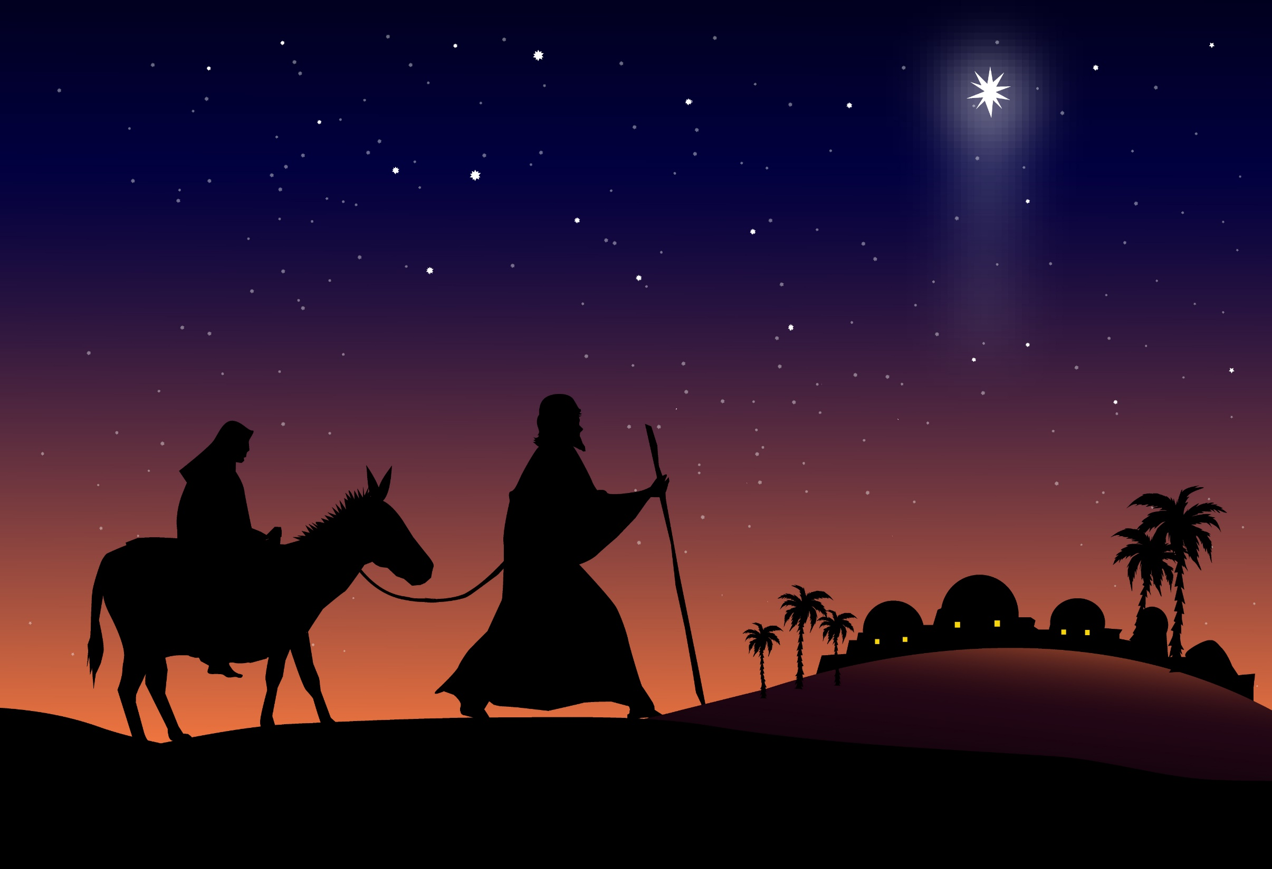
Notes:
We often picture the story – Mary and Joseph travelling to Bethlehem.
Mary’s pregnant and suddenly her waters break.
They’ve gotta find a place to stay urgently.

Slide 21
Notes:
They rush into Bethlehem. Desperate for a place to stay. ANYWHERE.
But the town’s full – and there’s no room in the local hotel.
But fortunately there’s this INN-KEEPER – a resourceful guy – who makes some room for them in the stables.

Slide 22
Notes:
And just in time – Mary gives birth to Jesus.
A cheery, happy little birth. Mum. Dad. And little baby Jesus.
Happy and safe. Together.
A nice little story to tell at Christmas time.

Slide 23
Notes:
A nice CLEAN story
…No major hiccups here…

Slide 24
Notes:
But there’s a couple of MYTHS in this CLEANED-UP story that just don’t fly.

Slide 25
While they were there, the time came for the baby to be born,
LUKE 2:6
Notes:
For starters – They myth that suddenly Mary’s waters break before they arrive in Bethlehem.
No - Mary and Joseph are already in Bethlehem when her waters break.
THEY’VE ALREADY FOUND A PLACE – when the time comes for Jesus to be born.
So the drama in the story isn’t about a BOOKED OUT BETHLEHEM

Slide 26
... and she gave birth to her firstborn, a son. She wrapped him in cloths and placed him in a manger, because there was no guest room available for them.
LUKE 2:7
Notes:
And the hero in the story isn’t the industrious INN-KEEPER…
In fact - there’s actually no mention of an INN-KEEPER.
…Or an INN.
It’s true that Jesus is born in a MANGER.
…But not because there’s no room in THE LOCAL HOTEL…

Slide 27
... and she gave birth to her firstborn, a son. She wrapped him in cloths and placed him in a manger, because there was no guest room available for them.
LUKE 2:7
Notes:
…But because there’s no GUEST ROOM available.
The GUEST ROOM- the furnished space in the upper level of the house. …The sort of place you’d set aside for a pregnant woman. …But we’re told it’s not available, why?
IT’S THE BEST PLACE FOR MARY AND JOSEPH – BUT THEY’RE SHUT OUT
WHY??
Surely Joseph had family. Why didn’t they prepare A PLACE?

Slide 28
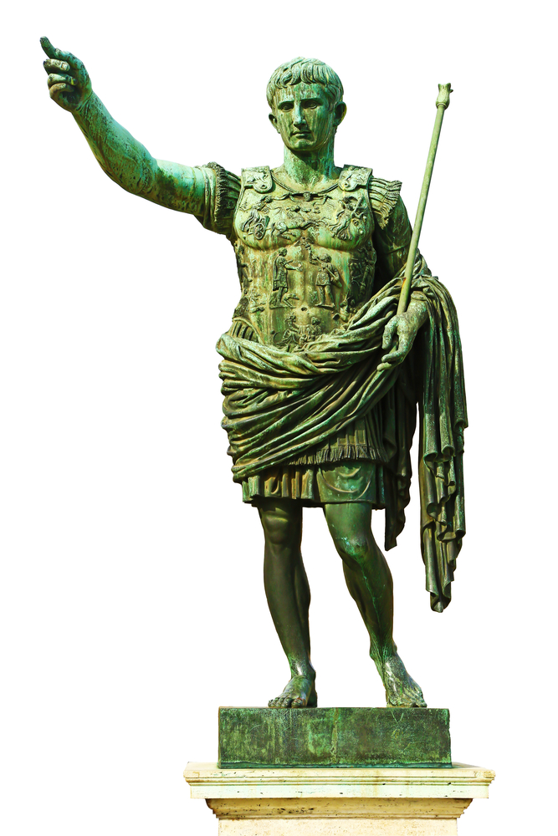
CAESAR AUGUSTUS
Notes:
Coz remember – the whole reason they’re heading to Bethlehem is for this CENSUS.
…issued by CAESAR AUGUSTUS
Joseph is heading to BETHLEHEM because it’s his HOMETOWN.
…So where’s his FAMILY? Why hasn’t anyone prepared a PLACE for them?
…‘specially for a pregnant woman??

Slide 29
Notes:
Imagine that long trek –almost A WEEK’S JOURNEY –
…But hoping there’ll be a good place to stay
…Hoping the family have sorted it out…made the arrangements
…A comfy place for Mary, Joseph, and baby

Slide 30
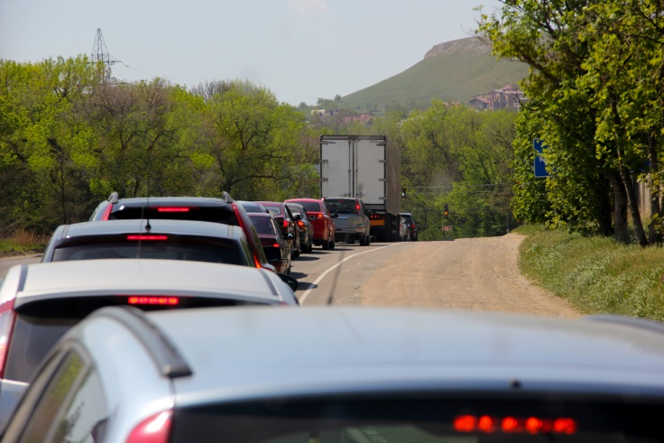
Notes:
WE’VE GOT OUR OWN PROBLEMS WITH TRAVEL TODAY
…Lots of cars on the road at Christmas
…You just hope the destination is worth the long trip
#STORY#
Like what happened to us one year – CAMPING NEAR BALLINA
We turn up to our campsite…there’s no shade, no toilets, and no showers
And our campsite? A few metres of dirt sandwiched between two caravans
NO ONE WANTS TO DO A LONG TRIP
…ONLY TO ARRIVE AT SOME CRUMMY OLD PLACE

Slide 31
... and she gave birth to her firstborn, a son. She wrapped him in cloths and placed him in a manger, because there was no guest room available for them.
LUKE 2:7
Notes:
So wonder how Mary and Joseph felt when they finally arrive in Bethlehem
…Meet the family in the house
…Only to find there’s NO GUEST ROOM AVAILABLE for them
So what’s up with Joseph’s family?
Why do they give Mary and Joseph the cold shoulder?
Why’s no one prepared a place for them?

Slide 32
Notes:
This is where the story gets messy.
Coz remember - Mary and Joseph are engaged but not married.
Mary’s pregnant out of wedlock and says the baby is a MIRACLE FROM GOD.
But you’d imagine the word on the street is that MARY’S BEEN UNFAITHFUL

Slide 33
Notes:
Imagine the SHAME –
…the SHAME to Joseph
…and the SHAME to his family…
The SHAME – to have this woman come stay with your family?
Guess Joseph’s family want none of it.

Slide 34
Notes:
So when Mary and Joseph arrive in Bethlehem – the NO VACANCY sign goes up
…There’s no warm welcome when they arrive… …No doting grandparents. …No weird uncles.

Slide 35
... and she gave birth to her firstborn, a son. She wrapped him in cloths and placed him in a manger, because there was no guest room available for them.
LUKE 2:7
Notes:
NO ONE’S PREPARED A PLACE FOR THEM.
…there’s a GUEST ROOM – but it’s not available
…No, no - that’s for Aunty Mavis…and her poodle…
NO PLACE for Mary and Joseph.
And NO PLACE for Jesus.
No ROOM for MESS.

Slide 36
... and she gave birth to her firstborn, a son. She wrapped him in cloths and placed him in a manger, because there was no guest room available for them.
LUKE 2:7
Notes:
NO ROOM – except this MESSY ROOM where animals are kept

Slide 37
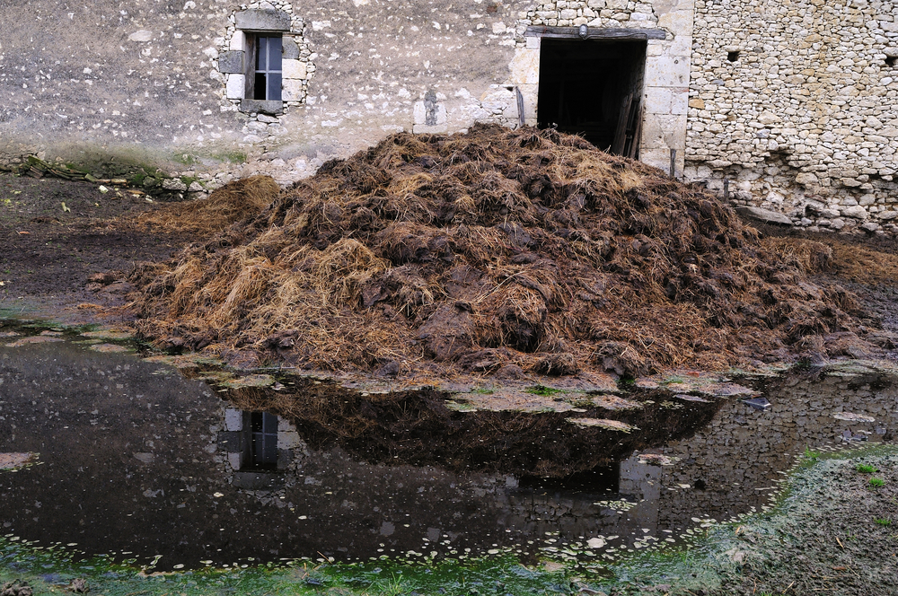
Notes:
Not exactly a room with a view
We don’t think much about the mess of animals
…Maybe you put some manure on your garden …But unless you’re a farmer – probably don’t think much about MANURE

Slide 38
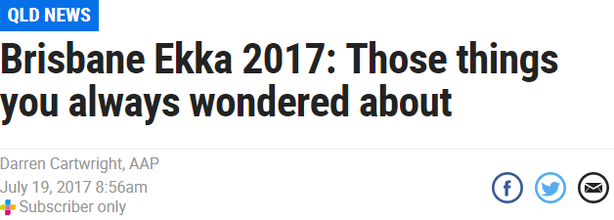
Notes:
…When the Ekka comes to town you get a glimpse – all those animals…there’s lots of poo to clean up.
…About 16 TONNES OF MANURE – over 10 days
…Enough to fill 8 family-sized cars

Slide 39
Notes:
See you can’t call this a clean, tidy birth story
…not like the tacky scene pictured here – it was MESSY

Slide 40
Notes:
Especially MESSY coz Jesus is rejected by his family. …Rejected for being too messy.

Slide 41
Notes:
MOVEMENT 3 – APPLICATION
So what place is there for messy Jesus in your life?

Slide 42
Notes:
I’m sure we’d love a Christmas free of mess.
No mess. No stress. That’s the dream, isn’t it.

Slide 43
Notes:
But Jesus couldn’t escape the mess.
And he doesn’t hide from the mess.
In fact he came to enter our messy world. He came for messy people like us.

Slide 44
Notes:
He came and was rejected…

Slide 45
Notes:
He died – for messy people like us.
He died - so you can come to him and receive this clean up by God.
He invites you to come as you are – in the midst of your mess. To be honest about the mess. To face up to the mess. But to let him clean you up.

Slide 46
Notes:
NOT LIKE AT CHRISTMAS
….WHERE YOU STICK PRETTY DECORATIONS ON A DIRTY OLD HOUSE.
Jesus has come to clean us up on the inside.

Slide 47
Notes:
So don’t settle for a stingy God who wants you to CLEAN YOURSELF UP
Don’t miss out on our God who wants to CLEAN YOU UP – only through Jesus

Slide 48
Let every heart prepare him room…
JOY TO THE WORLD
Notes:
In a moment we’re gonna sing JOY TO THE WORLD
”Let every heart prepare him room” – This is an invitation for you…for all of us.
But it’s also a promise – that when we welcome Jesus in and MAKE HIM ROOM
The stunning promise is that it’s Jesus who will MAKE ROOM FOR US!
He’s preparing A PLACE FOR US!

Slide 49
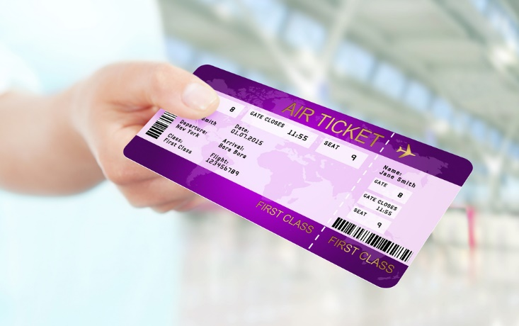
Notes:
#STORY#
Back in 2010 – I flew to the Philipinnes with a stopover at Hong Kong
…We’re at the airport 7 hrs waiting for our next flight.
…But when time gets close we’re told they’ve made a mistake with our flight.
Somehow they overbooked the flight – so they told us they’d upgrade us to FIRST CLASS free of charge…
THE UPGRADE WAS WORTH IT -

Slide 50
Notes:
WHATEVER YOUR HOLIDAY TRAVEL IS LIKE –
…With Jesus – the destination is worth the journey
…It’s WORTH IT – coz Jesus is preparing a place for us

Slide 51
Notes:
This is part of his PLAN.
…A seemingly messy plan.
…But God’s incredible plan to rescue us
…Come back tomorrow as we hear more about this Messy Story...

Slide 52
Notes:
And come back next Sunday – as we kick off our series, “A HOME IN THE MESS”

Slide 53
Notes:
…Preparing for our Term 1 series in Luke’s Gospel, THE WAY HOME

Slide 54
Notes:
PRAY

